Slide 1

Smart Streetlight Proof of Concept
Thor Cutler
Tucker Russ
Anthony Giordano
Brandon Berry
Group 3
02/25/16

Slide 2
Overview
Group 3
Tucker
Introduction
Solution
XBee Configuration
XBee Frame Comprehension
Model Design
Battery Backup System
Circuit Design
Shark Tank Progress

Slide 3
Introduction
Group 3
Tucker
Fully working Smart Streetlight System Demo Model
Give exposure to new Smart Grid Technology
Build system using our design and programs
Minimum of two Streetlights and a User Interface Device
Show advantages of implementing Streetlights on our Campus

Slide 4

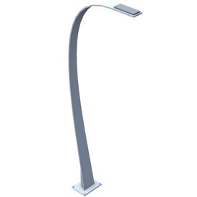

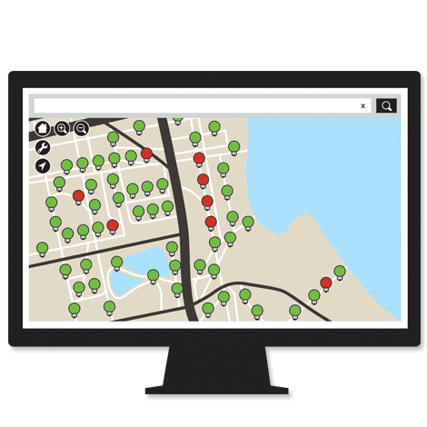
Smart Streetlight System Scenario
Group 3
Tucker
When a Streetlight, House, or Campus Building loses power
The utility company will be immediately notified of the outage and the location through the User Interface Device
Notes:
This allows them to not only know the exact time of the outage but also if other devices are effected (Ill talk more about that) and the exact location so they can pinpoint the problem which leads to less troubleshooting

Slide 5
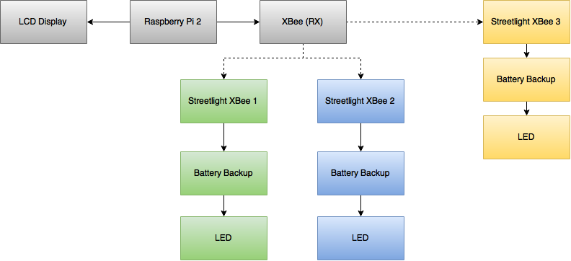
Top-level Model Hardware Design
Group 3
Tucker

Slide 6
System Requirements
Group 3
Tucker
Requirement Code | Requirement Statement | Need Mapping | Explanation
R_S1 | The SSLS shall alert a user within 10 seconds of a monitored device losing power. | N_S1 N_S2 | The purpose of this requirement is to document one of the basic functions of our project. When a street light or smart meter loses power, the system user, by looking at the system’s monitor, will be alerted of the power loss.
R_S2 | The SSLS shall constantly show the status of all monitored devices, updating every 10 seconds. Status consists of: -Powered on or off -last updated -voltage -current -power | N_S3 N_S4 N_S8 N_Want1 N_Want3 N_Want4 | The purpose of this requirement is to ensure that the system will constantly be updating data on a set time interval and not just when a monitored device loses power.
R_S3 | The SSLS shall receive status signals from monitored devices wirelessly. | N_S5 N_S6 N_S7 | The purpose of this requirement is to simulate that street lights are far enough apart that a wired connection isn’t practical
R_S4 | The SSLS shall be able to differentiate between different monitored devices by the signal that they send. | N_S7 | The purpose of this requirement is to ensure that each light sends a slightly different signal as to allow the user to know which light has lost power.

Slide 7
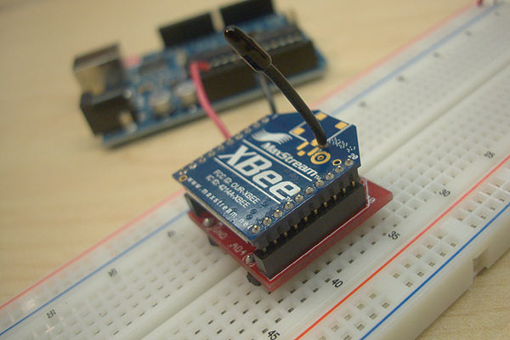
XBee Series 1
Group 3
Thor
2.4GHZ using IEEE 802.15.4
P2P and multi-point Mesh Network
3.3V, 50mA Input
300ft max outdoor range
1mW Output
6 10-bit ADC input pins
65536 Channels
Local or over-air configuration

Slide 8
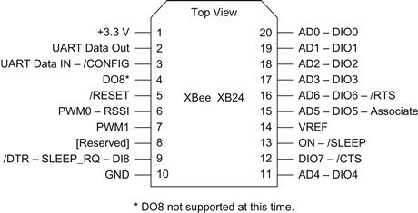
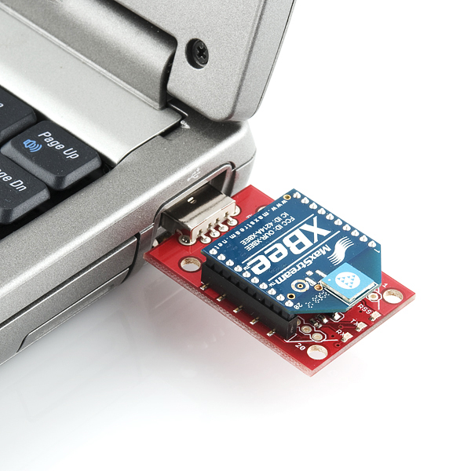
XBee Configuration
Group 3
Thor
XBee devices are configured using X-CTU, a free multi-platform application by Digi
X-CTU allows each XBee device to be flashed with personal settings, such as using a certain pin as a digital input.

Slide 9
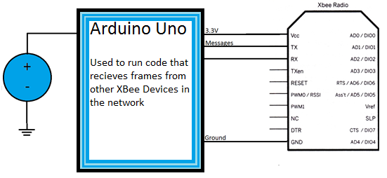
XBee Frame Testing
Group 3
Thor
In order to check frames received, an Arduino was connected to a XBee Device and a program was written to display the frames on a computer

Slide 10
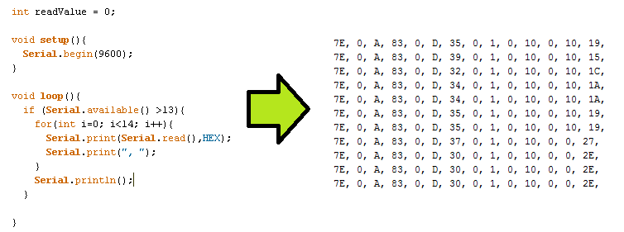
XBee Frame Testing
Group 3
Thor
Code written in Arduino IDE to collect the data frames and print them out to be interpreted

Slide 11
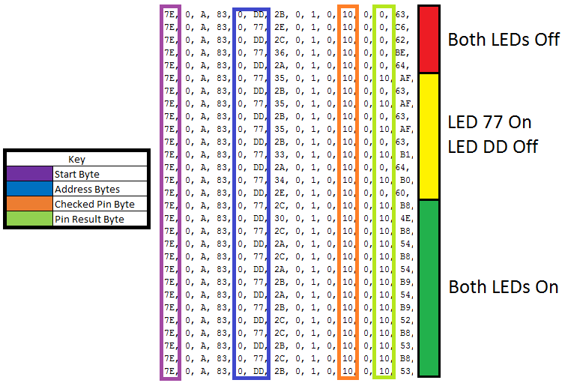
Group 3
Thor

Slide 12
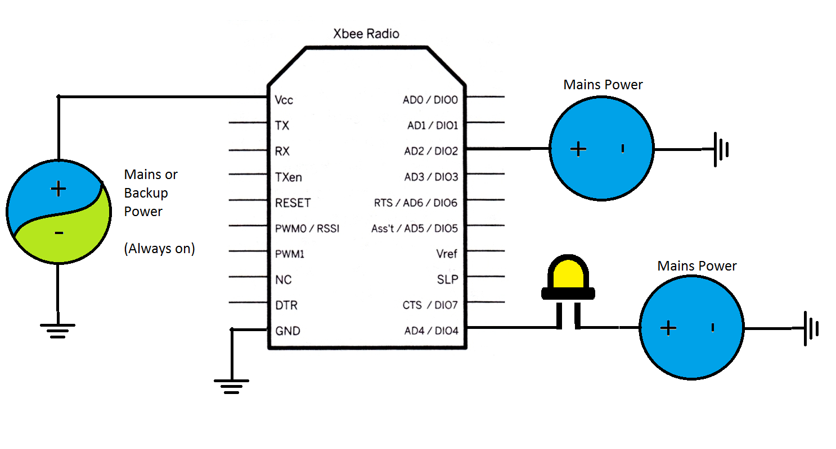
XBee Frame Testing
Group 3
Thor
Using the address in the frames, and a look-up table, the locations of various streetlights could be stored
In this example only pin-4 was used, but I plan on also using pin-2 (Check-Pin Bytes will become 14 instead of 10) to check if the LED is out as seen below. (Brandon will go into more detail)

Slide 13

Buildings and Streetlights for Model
Group 3
Brandon
3D printed buildings to model a campus setting
Clear 3D printed streetlights to show inner electronic components
3 Streetlights (2 fixed and 1 mobile)

Slide 14
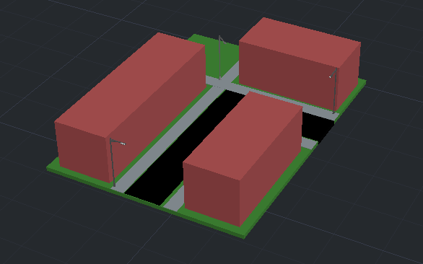
Building Layout of Model
Group 3
Brandon

Slide 15
Power Layout of Model
Group 3
Brandon
Smart Meter
w/XBee
LED
120V
5V DC
5V
Streetlight 1
5V DC
5V
Streetlight 2
120 V
5V DC
5V
User Interface
5V DC
5V
Streetlight 3
120 V

Slide 16
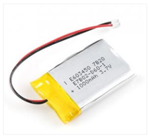
Why is a backup battery needed?
Group 3
Brandon
If the power supplied to the streetlight fails, the backup battery will provide enough power to allow the XBee to still transmit for 6+ hours for the model
The battery capacity would be scaled up with a full size design
This will allow for the ability to notify the user interface when the power to a streetlight has gone out
Once the system regains outside power, the battery will begin to charge back to its full capacity

Slide 17
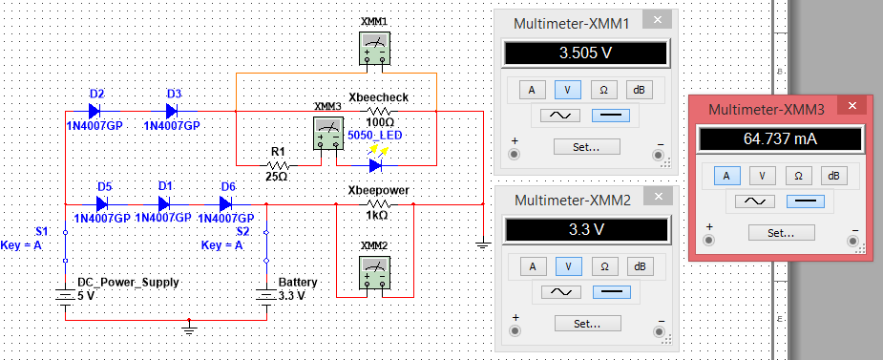
Original Node Power Circuit for XBee & LEDs
Group 3
Brandon

Slide 18
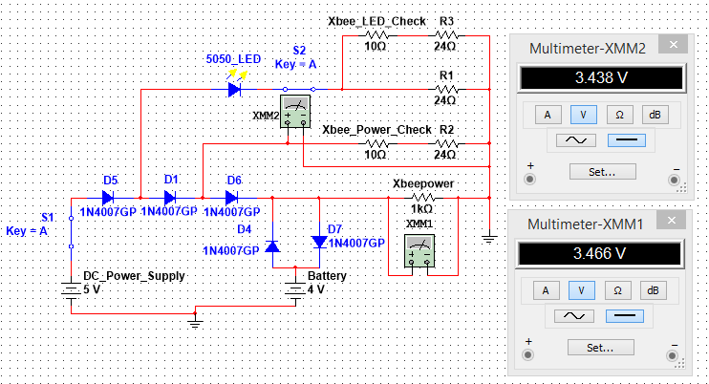
Updated Node Circuit While DC Power is Connected
Group 3
Brandon

Slide 19
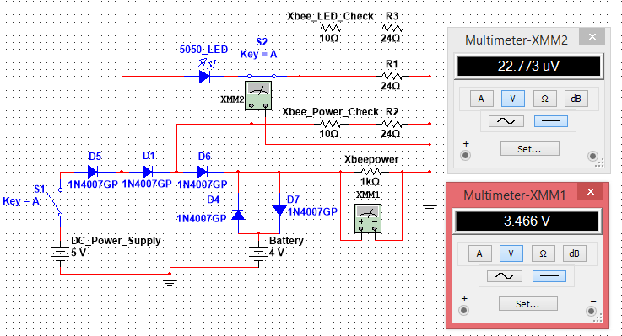
Updated Node Circuit While DC Power is Disconnected
Group 3
Brandon

Slide 20
While DC Power is Disconnected
Group 3
Brandon
Diodes are used to prevent the backflow of current when the DC power supply goes down
This allows the XBeeCheck to see that the DC power supply has stopped working while the XBee itself still receives power
A second check for when the LED goes out has been added to the circuit

Slide 21
XBee Check Readings
Group 3
Brandon
The voltage required to cause a “high” or “low” reading on the XBee:
Low < 0.9V
High > 0.9V
Each XBee check will be supplied over 0.9 volts to insure a high reading when needed
When the main power is lost or the LED goes out, the XBee checks will receive an insignificant voltage resulting in a low reading

Slide 22
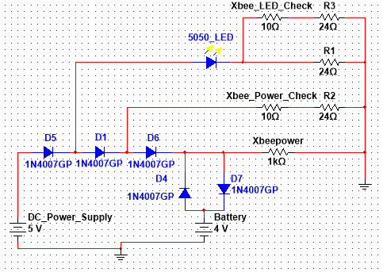
Actual Schematic for each Streetlight Node
Group 3
Brandon

Slide 23
Supplies List for each Streetlight Node
Group 3
Brandon
1 XBee
5 Rectifier diodes
1 4V Lithium-ion battery
3 24Ω Resistors
20 Gauge Wire
2 Toggle switches (for model purposes only)

Slide 24

Shark Tank
Group 9
Anthony

Slide 25

Marketing
Group 9
Anthony
Target market: College campuses
Travel to college campuses across the country to present idea
Product will be sold online through the Smart Streetlight website
Product will not be sold in retail

Slide 26

Selling Points
Group 9
Anthony
Provides quick response to streetlight outages
Increases safety providing reliable lighting
Inexpensive compared to competitors

Slide 27
XBee Options
Group 9
Anthony
Proof of Concept
Scaling Up
Device | Xbee series 1 | XBee-Pro | XBee Series 2.5
Indoor range | 100 ft | 300 ft | 133 ft
Outdoor range | 300 ft | 1 mile | 400 ft
Transmit power | 1mW | 63mW | 1.25 mW
Receiver sensitivity | -92 dBm | -100 dBm | -96 dBm
Supply voltage | 2.8-3.4 V | 2.8-3.4 V | 2.1-3.6
Transmit current | 45 mA (@3.3V) | 250 mA (@3.3V) | 40 mA (@3.3V)
Receive current | 50 mA (3.3V) | 55 mA (3.3V) | 35 mA (@3.3V)
Power down current | < 10 uA | <10 uA | < 1 uA
Operating frequency | 2.4 GHz | 2.4 GHz | 2.4 GHz
Operating temperature | -40 to 85 Deg C | -40 to 85 Deg C | -40 to 85 Deg C

Slide 28
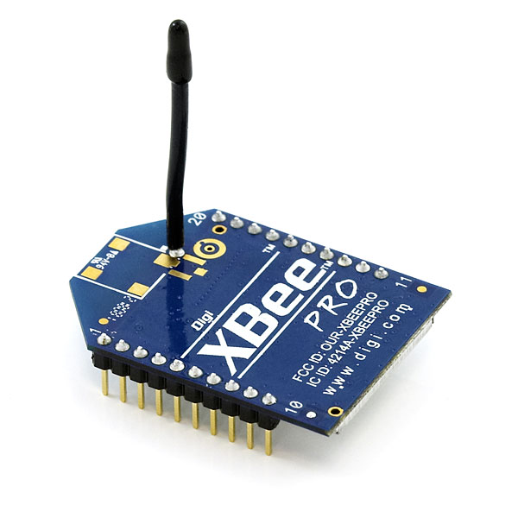
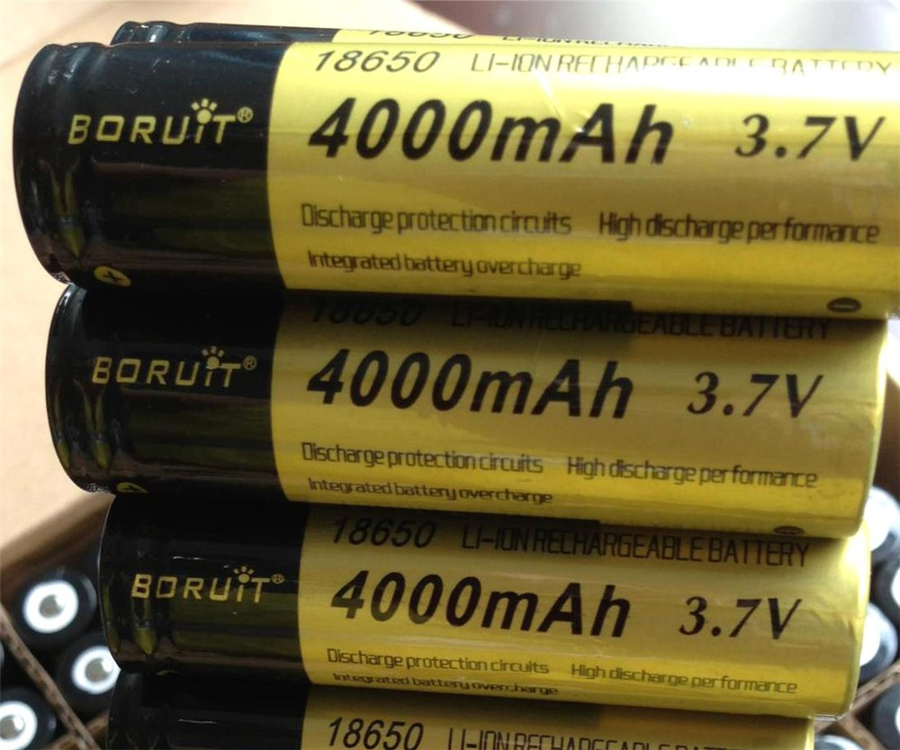
Scaling Up
Group 9
Anthony
XBee Pro
Outdoor range: 1 mile
Transmit Power: 63mW
Supply Voltage: 2.8V – 3.4V
Cost: $40.00
Lithium Ion Battery
4000 mAh
Up to 72 hours of power (disregarding losses)
Cost: $20.00

Slide 29
Production Cost of Streetlight Fixture
Group 9
Anthony
XBee Pro | $40.00
Breadboard | $4.00
Wires | $2.00
4000 mAh Lithium Ion Battery | $20.00
Various Dropdown Circuit | $14.00
Total | $80.00

Slide 30
Competitors Vs. SSL
Group 9
Anthony
General Electric’s LightGrid
Smart Streetlights
Multiple wireless features to monitor and control lights
Requires Internet Access
Up to$400 per light
Addition software license costs
Single wireless feature to check status of lights
No internet access required
Approximately $80.00 per light
One time purchase (no contract)

Slide 31

Competitive Advantage
Group 9
Anthony
Simple solution for monitoring the status of each individual streetlight
Cost efficient alternative to replacing full streetlight

Slide 32
Questions?
Group 9

